Slide 1
Forensic Examination of Documents - Facts & Fundamentals
Compiled by
C. Rajesh
Assistant Director & Scientist ‘C’ (Documents)
Documents Division
Central Forensic Science Laboratory Hyderabad

Slide 2
DOCUMENT - Definition
The word ‘Document’ denotes any matter expressed or described upon any substance by means of letters, figures or marks or by more than one of those means, intended to be used, or which may be used, as evidence of that matter.
- Section 29 of I.P.C. & Section 3 of Indian Evidence Act.

Slide 3
Forensic Document Examination
The application of science and analytical techniques to questions concerning documents is termed forensic document examination. The examination of questioned documents consists of the analysis and comparison of questioned handwriting and other documentary evidence with known material in order to establish the authenticity of contested material as well as the detection of alterations.

Slide 4
Scope of Forensic Document Examination by Documents Division of CFSL, Hyderabad
Qualitative Examination of the following Types:
Handwriting Identification and Forgery Detection
Examination of Indentations
Examination of Ink & Paper
Examination of Torn Documents
Examination of Rubber Stamp Impressions & Dry Seal Impressions
Examination of Altered Documents
(By employing Non-destructive Techniques)

Slide 5
INTENDATIONS
Intendations are non-visible images applied to a sheet of paper positioned below the page actually written upon. Impressions from the writing instrument is captured on sheets of paper below the one that contains original writing in the form of grooves.
Recovered using: Oblique (glancing) light examination or ESDA

Slide 6
Examination of INK & PAPER
Non-destructive examination of Ink and Paper
Examination under various light conditions

Slide 7
Examination of TORN DOCUMENTS
To determine whether the paper samples originate from a single piece or not.

Slide 8
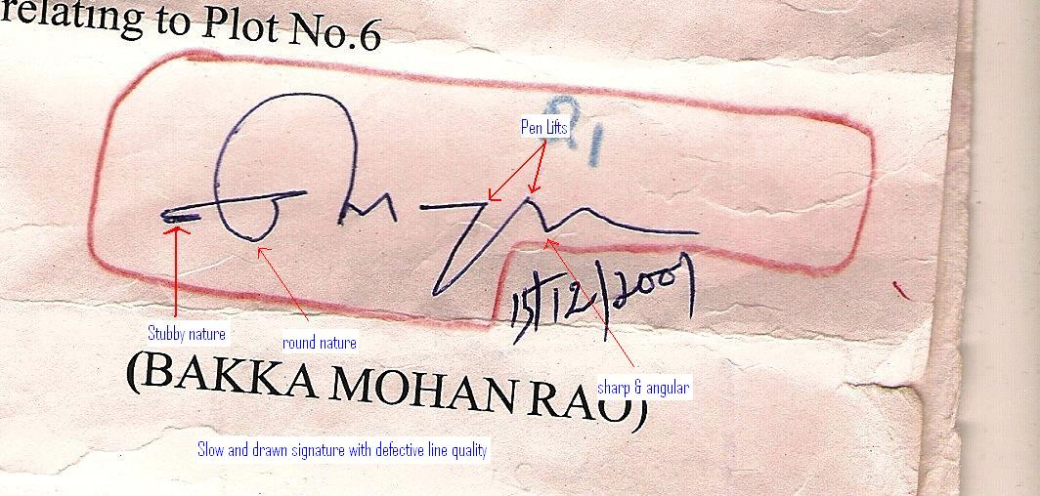
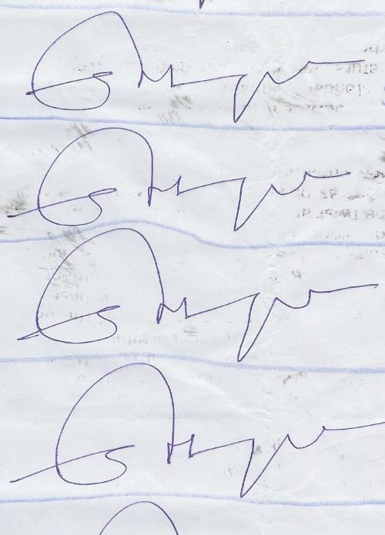
Handwriting Identification
A discriminatory process that derives from the comparison of writing habits, and an evaluation of the significance of their similarities or differences.
Analysis
Comparison
Evaluation

Slide 9
PRINCIPLES OF HANDWRITING IDENTIFICATION
Principle of Habituation:
“Writing is an acquired skill that is a complex neuromuscular coordinated activity”
“The execution of writing is a voluntary act that follows behaviour patterns learned as writing habits”
Principle of Heterogeneity:
“As a complex neuromuscular coordinated task, writing is heterogeneous”

Slide 10
PRINCIPLES OF HANDWRITING IDENTIFICATION
“In handwriting identification, what analysis has found and comparison has revealed, only proper evaluation can render useful”
“The identification of a writer is a consequence of the evaluation of similarities; the elimination of or differentiation between writers (non-identity) is a consequence of the evaluation of differences”

Slide 11
PRINCIPLES OF HANDWRITING IDENTIFICATION
Principle of Natural Variation:
“The imprecisions with which the writing habits of a writer are executed on repeated occasions”
(An inherent property of genuineness)

Slide 12
PRINCIPLES OF HANDWRITING IDENTIFICATION
Principle of Exclusion and Inclusion: “One cannot exclude from one’s own writing those discriminating elements of which one is not aware, or include those elements of another’s writing of which one is not cognizant”
Principle of Interference: “It is a greater task to duplicate another’s writing habits that are similar to, but discriminable from one’s own, because of the difficulty in maintaining subtle or minor changes to one’s normal writing habits”

Slide 13
PRINCIPLES OF HANDWRITING IDENTIFICATION
Complexity Theory: Complexity theory introduces three relationships involving complexity in handwriting that are thought to exist:
1. “The more concatenated strokes there are, the higher the complexity of writing”
2. “The higher the complexity, the less likelihood of encountering a ‘chance match’ of features with another writer”
3. “The higher the complexity, the more difficult it is to simulate the writing without evidence of simulation process”

Slide 14
PRINCIPLES OF HANDWRITING IDENTIFICATION
Principle of Comparison:
“For an effective comparison, like material has to be compared with like.”

Slide 15
HANDWRITING CHARACTERISTICS
Class Characteristics: The elements, or qualities of writing that situate a person within a group of writers or that give a written communication a group identity. These are general characteristics that are shared with other systems.
Individual Characteristics: Those discriminating elements (writing habits) that serve to differentiate between members within any or all groups.

Slide 16
HANDWRITING CHARACTERISTICS
Huber & Headrick segregated the discriminating elements of writing (or handwriting characteristics or writing habits) into two principal categories:
Elements of Style: Arrangement, Class of Allograph, Connections, Design & Construction of Allographs, Dimensions, Slant, Spacing.
Elements of Execution: Abbreviations, Alignment, Commencements & Terminations, Diacritics & Punctuation, Embellishments, Legibility or Writing Quality, Line Continuity, Line Quality, Pen Control, Writing Movement.

Slide 17
Instrumention - Forensic Document Examination
Hand Magnifiers
Stereo Microscope
Video Spectral Comparator (VSC)
Electrostatic Detection Apparatus (ESDA)

Slide 18

HAND MAGNIFIER
Simple hand held magnifiers, which can enlarge the script from 2 to 10 times (magnification powers of 2x to 10x)

Slide 19

STEREO MICROSCOPE
An optical microscope variant designed for low magnification observation of a sample. Produces a three-dimensional visualisation of the sample being examined.

Slide 20
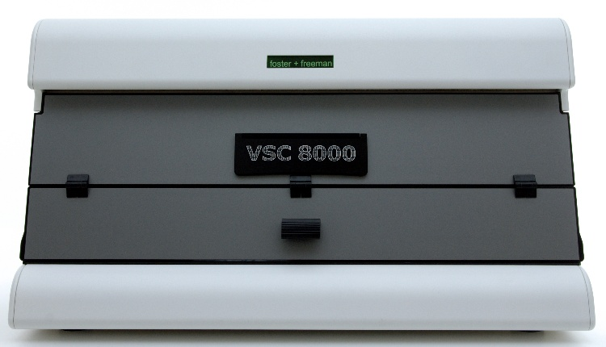
VIDEO SPECTRAL COMPARATOR (VSC)
It is a imaging device that allows an examiner to magnify the document, analyze inks, visualize hidden security features and reveal alterations on a document.

Slide 21
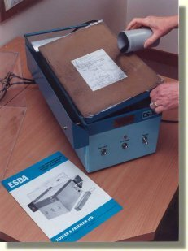
ELECTRO STATIC DETECTION APPARATUS (ESDA)
An Electro Static Detection Apparatus (ESDA) is used to visualize indentations by applying an electrostatic charge to a transparent film. The film is laid across the page in question and once the charge has been applied, black toner is passed across the film and reveals any indentations.

Slide 22
Age of Document or Writing
At present, there is no validated and accepted scientific technique available in Central Forensic Science Laboratory for determining absolute or relative age of writing or ink or document. In view of these, it is not possible to determine the age of document or writing.

Slide 23
Handling Disputed Documents
Keep the document in a protective envelope preferably transparent one. Lamination is not advisable.
Don’t handle a disputed document excessively.
It should not be cut, torn, punched, folded or unfolded or mutilated in any way.

Slide 24
Handling Disputed Documents
It should not be touched with erasure of any kind or pen, pencil in any way in order to point out something on it.
Document should not be exposed to excessive heat, strong light or moisture etc.
The repair of the document should be done with great caution. If pasting of any torn parts is required it should not be done with an opaque material but with transparent adhesive tapes.

